Slide 1
Case study: personalized game recommendations on the mobile Internet

Slide 2
Case studies in recommender systems
The MovieLens data set, others
focus on improving the Mean Absolute Error …
What about the business value?
nearly no real-world studies
exceptions, e.g., Dias et al., 2008.
e-Grocer application
CF method
short term: below one percent
long-term, indirect effects important
This study
measuring impact of different RS algorithms in Mobile Internet scenario
more than 3% more sales through personalized item ordering

Slide 3
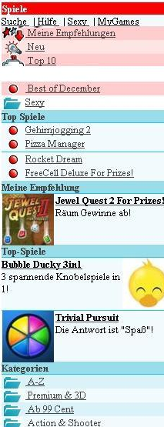
Application platform
Game download platform of telco provider
access via mobile phone
direct download, charged to monthly statement
low cost items (0.99 cent to few Euro)
Extension to existing platform
"My recommendations"
in-category personalization (where applicable)
start-page items, post-sales items
Control group
natural or editorial item ranking
no "My Recommendations"

Slide 4
Study setup
6 recommendation algorithms, 1 control group
CF (item-item, SlopeOne), Content-based filtering, Switching CF/Content-baaed hybrid, top rating, top selling
Test period:
4 weeks evaluation period
about 150,000 users assigned randomly to different groups
only experienced users
Hypothesis (H1 – H4)
H1: Pers. recommendations stimulate more users to view items
H2: Person. recommendations turn more visitors into buyers
H3: Pers. recommendations stimulate individual users to view more items
H3: Pers. recommendations stimulate individual users to buy more items

Slide 5
Measurements
Click and purchase behavior of customers
customers are always logged in
all navigation activities stored in system
Measurements taken in different situations
my Recommendations, start page, post sales, in categories, overall effects
metrics
item viewers/platform visitors
item purchasers/platform visitors
item views per visitor
purchases per visitor
Implicit and explicit feedback
item view, item purchase, explicit ratings

Slide 6
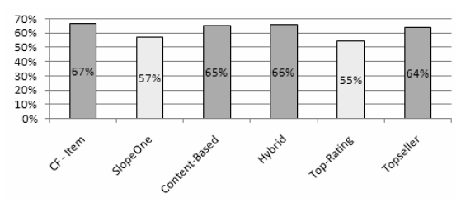
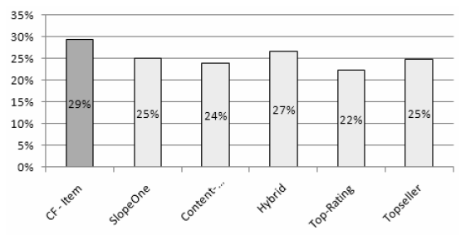
My Recommendations conversion rates
Item viewers / visitors Purchasers / visitors
Conversion rates
top-rated items (SlopeOne, Top-Rating) appear to be non-interesting
only CF-Item able to turn more visitors into buyers (p < 0.01)
Overall on the platform
no significant increase on both conversion rates (for frequent users!)

Slide 7
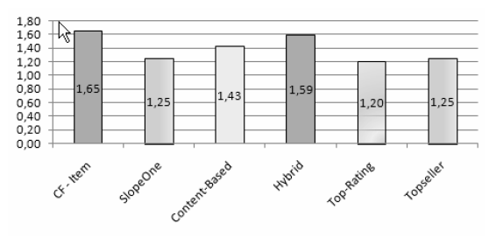
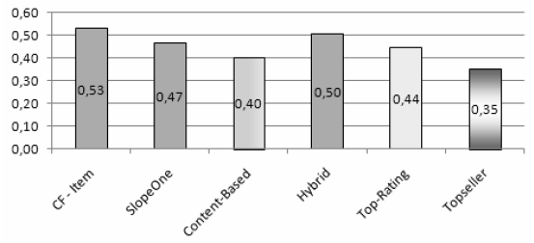
My Recommendations sales increase (1)
Item views/ customer Purchases / customer
Item views:
except SlopeOne, all personalized RS outperform non-personalized techniques
Item purchases
RS measurably stimulate users to buy/download more items
content-based method does not work well here

Slide 8
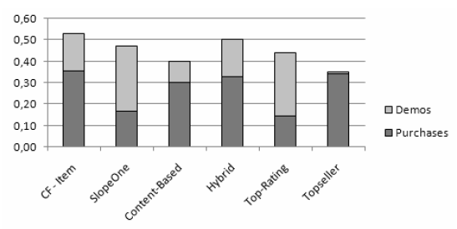
My Recommendations sales increase (2)
Demos and non-free games:
previous figures counted all downloads
figure shows
personalized techniques comparable to top seller list
however, can stimulate interest in demo games
Note, Rating possible only after download
Figure shows purchases per visitor rate
Note: Only 2 demos in top 30 downloads

Slide 9
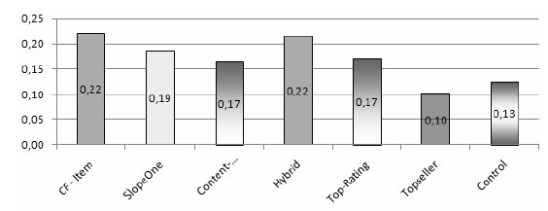
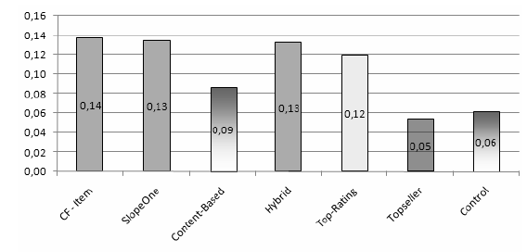
Post-sales recommendations
Item views / visitor Purchases / visitor
Findings
recommending "more-of-the-same", top sellers or simply new items does not work well
top-Rating and SlopeOne nearly exclusively stimulate demo downloads (Not shown)
top-Seller und control group sell no demos

Slide 10
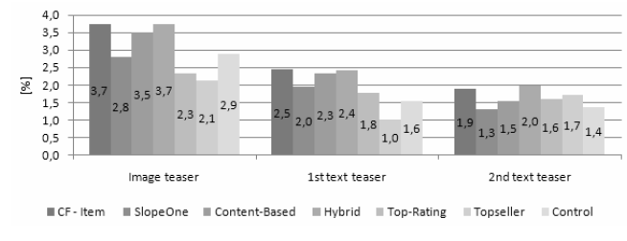
Start page recommendations
Example:
purchasers / visitors conversion rate
Findings:
visual presentation is important, click distribution as expected (omitted here)
personalization raises attraction also on text links
proposing new items works also very well on the start pages

Slide 11
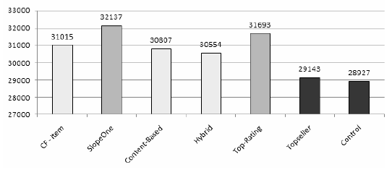
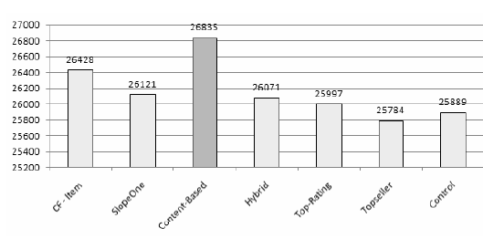
Overall effects
Overall number of downloads (free + non-free games)
Pay games only
Notes
In-category measurements not shown in paper.
Content-based method outperforms others in different categories
(half price, new games, erotic games)
Effect: 3.2 to 3.6% sales increase!

Slide 12
Further observations: ratings on the Mobile Internet
Only 2% of users issued at least one rating
most probably caused by size of displays
in addition: Particularity of platform; rating only after download
insufficient coverage for standard CF methods
Implicit ratings
also count item views and item purchases
increase the coverage of CF algorithms
MAE however not a suitable measure anymore for comparing algorithms

Slide 13
Summary
Large case study on business effects of RS
significant sales increase can be reached! (max. 1% in past with other activities)
more studies needed
value of MAE measure …
In addition
recommendation in navigational context
acceptance of recommendation depends on situation of user
Further work
comparison of general sales behavior
more information in data to be found

